Slide 1
Weekly Update
Jorian Bruslind
Week 6

Slide 2
HyperRail Project
Current Status
Integrated Software components into hardware
Verified GRBL controller accepts commands and is tied to Linux machine dynamically
Fixed bugs with motion controller / ROS packages
Updated Jetson Software to be in line with ROS noetic (Ubuntu 20.04)
Integrated MicaSense RedEdge Camera into design
Very unreliable hardware connections
Very reliable software connections
Purchased new camera for testing RGB / Visual NVDI analysis

Slide 3
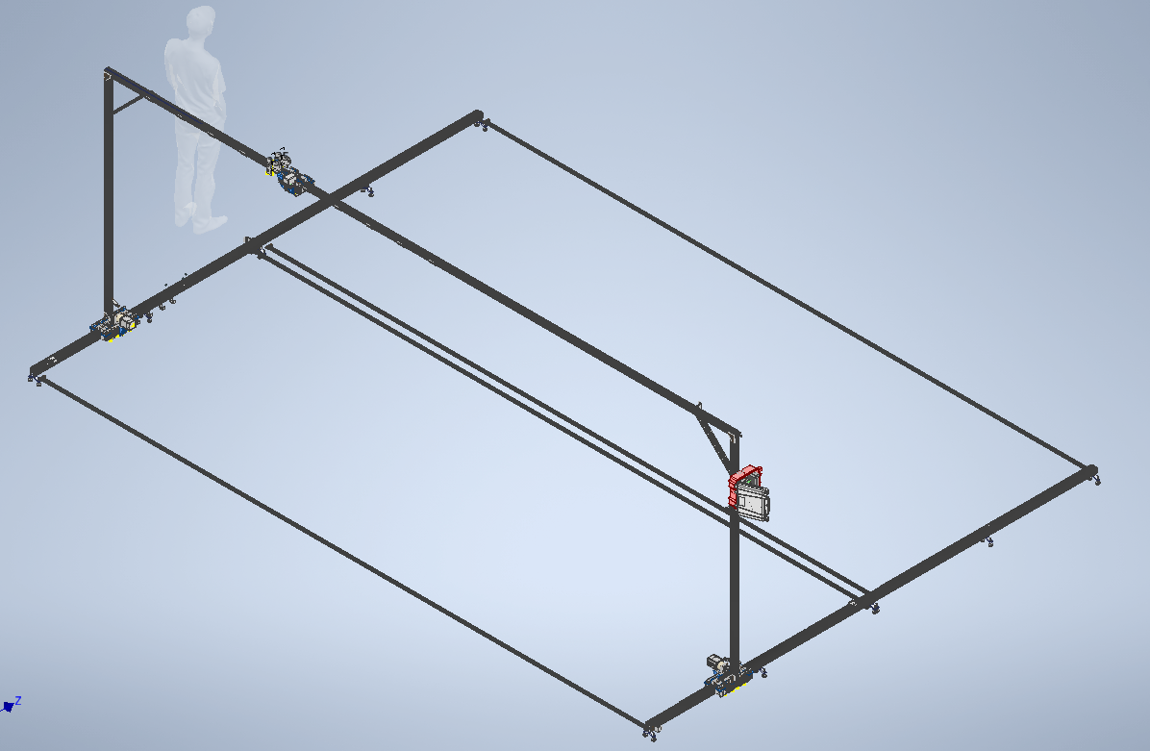
Current Status

Slide 4
Project Work
Working with both IE and ME capstone teams to develop hardware further
ME team is working on stability and assembly components
Better carriages (CNC aluminum vs 3D printed plastic)
Better wire guides (current guides are limited by length)
Festoons! <- One of the best ideas
Better structural stability
Employ tensioned cable as gusset supports
IE team working on documentation and assembly designs
Exploding 3D models into Lego-like designs
Writing and drafting instructions
User feedback for current system design (from user perspective)

Slide 5
Next Steps
Finish up camera testing to get full mosaic stitched together
Improve user interface for data downloads
Prep for installing system up at NWREC by last week of Feb, first week of March

